Slide 1
Metabolomics/lipidomics biomarker discovery
Dr. Animesh Acharjee
MRC Human Nutrition Research, Cambridge, UK
Department of Biochemistry, University of Cambridge, UK

Slide 2
Agenda
Introduction : Biomarker Discovery
Classification & regression
Random Forest
Hands on : Metabolomics data analysis

Slide 3
Background
What are biomarkers?
  A biomarker, or biological marker, is an indicator of a biological state or system (in the level of gene, metabolite and/or protein)
  Some of the important properties of a biomarker are
    Robust
    Predictive
    Indicative

Slide 4
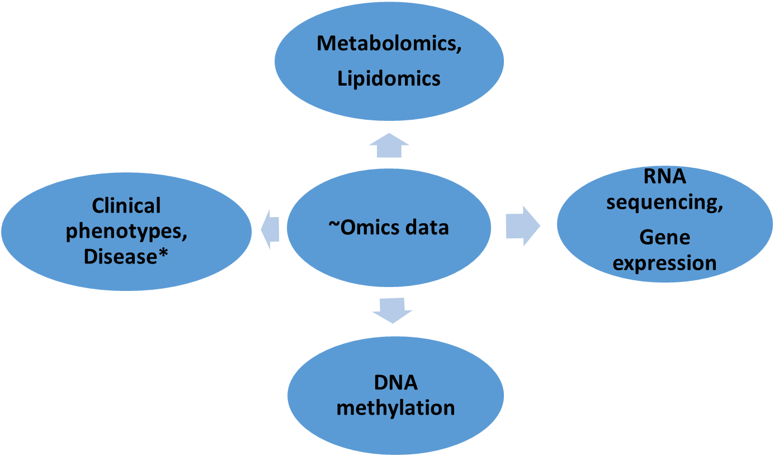
Overview of data sets
Disease*
Type-2 diabetes
Obesity
Liver cancer
Cardio metabolic diseases

Slide 5
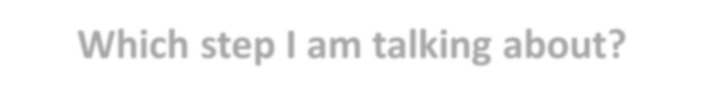
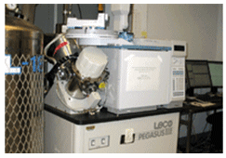
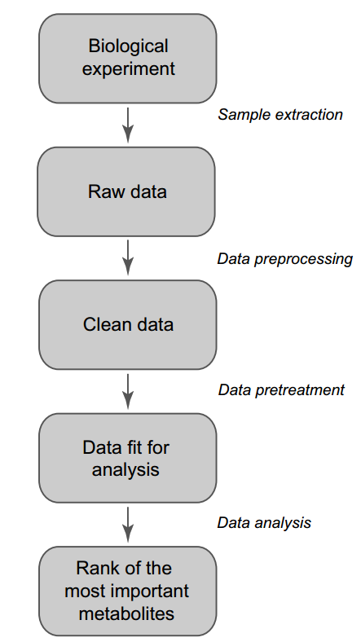
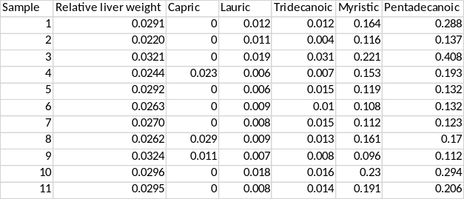
Which step I am talking about?
Select or Rank genes/metabolites/lipids
van den Berg et al., 2006

Slide 6

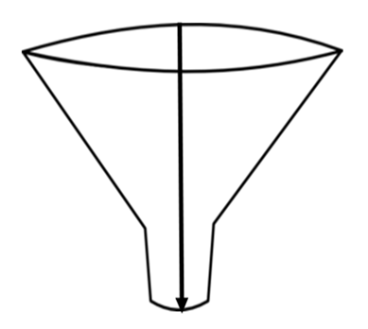
Candidate biomarkers
Statistical
Methods
Selected variables (metabolites/gene/protein)

Slide 7
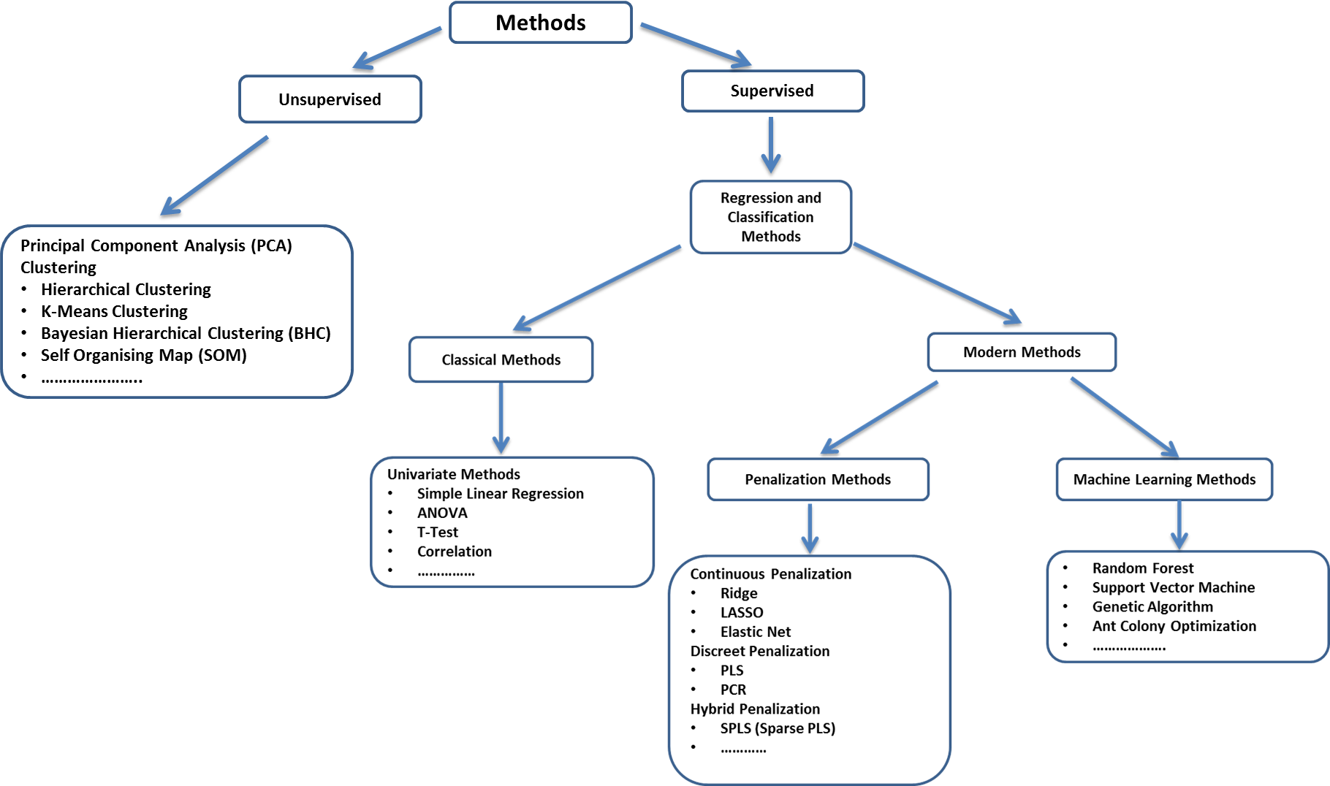

Slide 8
Agenda
Introduction : Biomarker Discovery
Classification & regression
Random Forest
Hands on : Metabolomics data analysis

Slide 9


Supervised Learning
y
(Continuous value
Or Class)
X
(-Omics data)
If “y” Continuous value => Regression approach
If “y” Class value => Classification approach

Slide 10
Classification : Basics
Also known as discriminant analysis (DA)
Find a ‘classifier’ distinguishing between two (or more) groups
Groups (classes) – known
Examples
  Control vs. disease => Binary
  Control vs. treatment 1, treatment 2, treatment 3 => Multi class
Goal 1: predict class of a new sample/observation
  Using its variable/feature values
  With high precision
Goal 2: selection of subset of variables with good classification

Slide 11
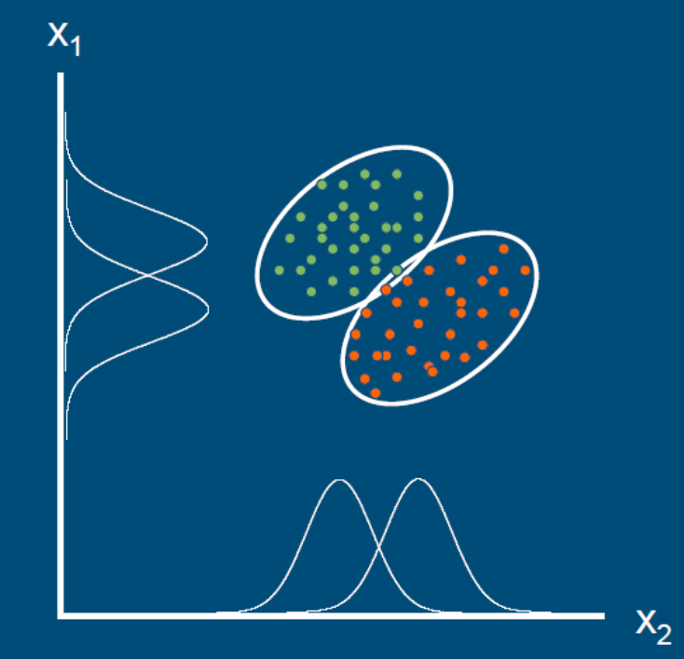
Classification / Discriminant analysis
Objects (samples) not separated very well by either x₁ or x₂
x₁ and x₂: Variables

Slide 12
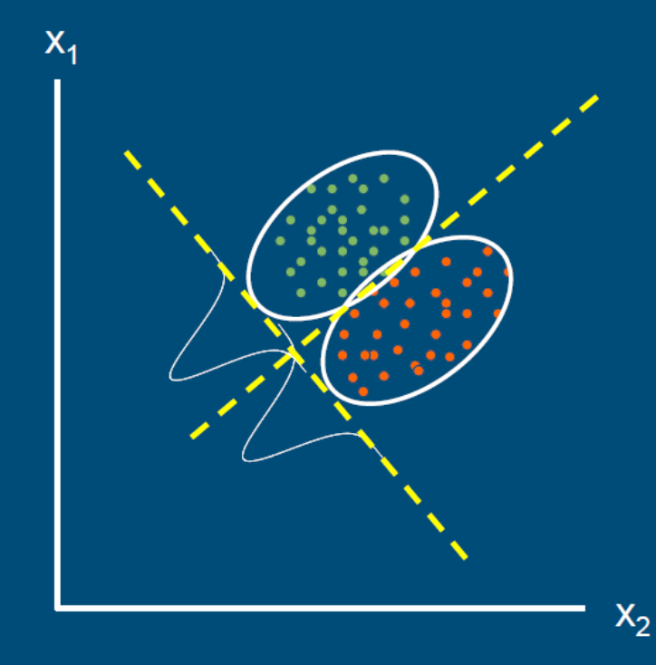
Classification / Discriminant analysis
Objects can be separated better using x₁ and x₂ simultaneously
Criterion: maximize between-class difference as compared to within-class differences

Slide 13
Classification / Discriminant analysis
Traditional methods for discriminant analysis
  Rely on having more objects than variables !
  (sometimes) assume equal ‘shape’
  (sometimes) assume multivariate normality
  (sometimes) use linear functions
Often not possible in big data sets [variables (p)>>objects (n)]

Slide 14
“large p, small n” problem
In reality, in big data:
  Few samples (typically 10-100) (n)
  Hundreds or variables (p)
  ‘Wide data’:
Few objects in a very high-dimensional space
  Data space is almost ‘empty’
  (Too) many possibilities for separating classes
  Serious risk of ‘overfitting’
    Perfect classification in current data
    No or hardly any predictive value for new samples
    Classifier uses also random differences and not just ‘true relationships’
Need to evaluate quality of classifier

Slide 15
Regression: Basics
Why we use regression?
  Modeling relationship between variables
  Predict outcome of one variable as a function of others
  Investigate the relative importance of the predictors
Assumptions : Linearity, Homoscedasticity, Independence, Normality
Types of regression
  Linear
    Simple linear
    Multiple linear
  Nonlinear/Curvilinear

Slide 16

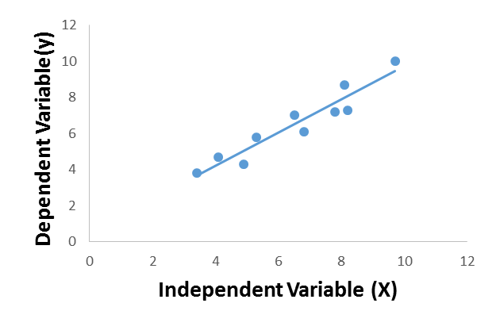

Regression: Basics
y=Dependent / response / outcome
X=Independent / regressor / predictor
=Random variable representing the result of both errors in model specification and measurement.
Number of observations (n)=10
Number of response variables (y) =1
Number of predictor variables (X) =1
How one variable changes with another
How “X” and “y” are behaving

Slide 17
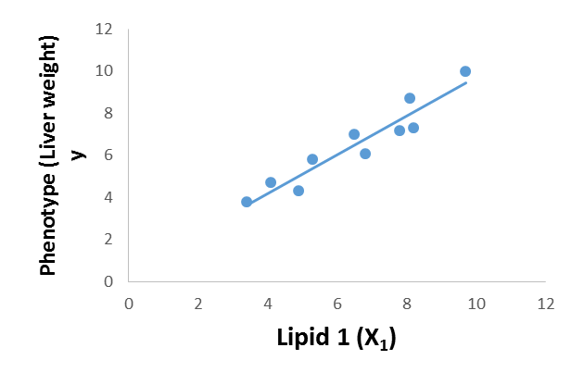

Regression: One example
Here:
y = Phenotype (Liver weight)
x₁ = Lipid 1
β₁
  y (Phenotype) = β₀ + β₁* X₁(Lipid 1) + Error
Slope / Coefficient/ Weights

Slide 18
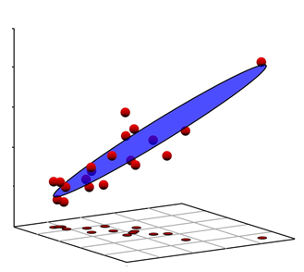
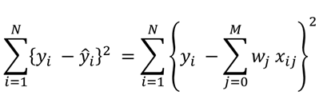
Multiple linear regression
Same example but with x₂:
y = Phenotype (Liver weight)
x₁ = Lipid 1
x₂ = Lipid 2
y =Phenotype
Regression Equation : Surface
  y (Phenotype) = β₀ + β₁* X₁(Lipid 1) + β₂ * X₂(Lipid 2) + Error
x₂ = Lipid 2
x₁ = Lipid 1
If nr. of variable= “p”, then
More general Equation: multidimensional surface
  y = β₀ + β₁*X₁+ β₂*X₂+ β₃*X₃… + β_{p}*X_{p}+ Error
Question:
Do you see any problem / Issue in this example?
Or in closed form

Slide 19
Multicollinearity
Lipid 1 (X₁)and Lipid 2 (X₂)might be correlated
Exact or near linear relationships between the x variables
Also called as : collinearity, near-collinearity or ill-conditioning
What are the consequences?
Regression coefficients
      Unstable (sensitive to small changes)
      Not uniquely defined
      Have high variance
      Coefficients can get the wrong sign
      Absolute values of regression coefficients can be absurdly high
      Impossible to interpret individually
      Relative importance of variables cannot be estimated reliably

Slide 20
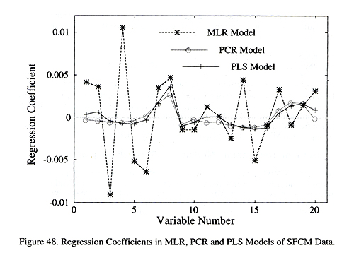
Bouncing betas
Consequences of Multicollinearity
The Elements of Statistical Learning: Data Mining, Inference, and Prediction
Trevor Hastie, Robert Tibshirani, Jerome Friedman

Slide 21
Also possible solutions
Use selected variables based on “some” criteria
Filter first on univariate methods (t-test, correlation, ANOVA)
  Problem
    Assumption is variables are independent
    Multiple testing
Dimension reduction (PCA, clustering)
Penalization methods
Machine learning methods

Slide 22
Agenda
Introduction : Biomarker Discovery
Classification & regression
Random Forest
Hands on : Metabolomics data analysis

Slide 23
Random forests (Breiman 2001)
Both classification and multiple regression
Handles high numbers of variables (p >> n)
Handles categorical and continuous predictors
Two-class and multi-class
Robust to large numbers of noise variables
Incorporates interactions between variables
Internal cross validation
Variable importance is estimated
Proximities between cases are computed
  can be used to do clustering (unsupervised)
Fast algorithm
Extension of ‘Classification and regression trees’ (CART)

Slide 24
Random forest
Ensemble method
  not one tree, but many
Each single tree unpruned
  Low bias, high variance
Introduce two forms of ‘randomness’
  Random training sets (bootstrap samples)
  Random variable selection at each node
Effects
  Individual trees are weak learners
    Low bias, low correlation, high variance
  Averaging over the trees retains low bias and reduces variance !
  ‘Bagging’ = bootstrap aggregation

Slide 25
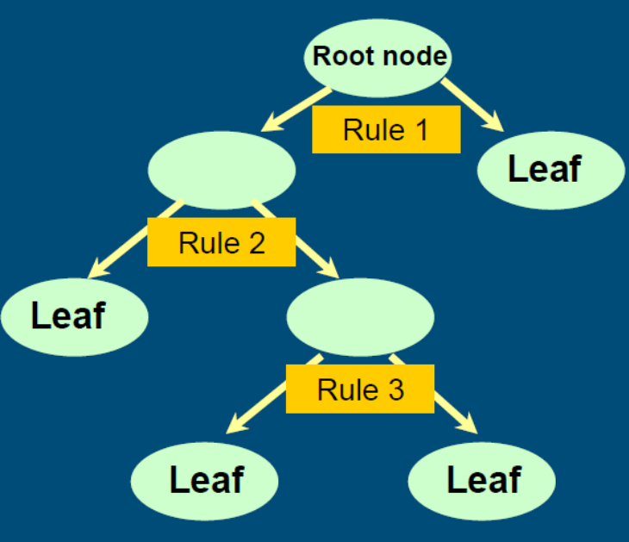
Example binary classification tree
The root contains all samples
Each subsequent node contains a subset of the samples
Each decision rule splits up the samples into two subgroups
Every rule is of the form
  x > t for continuous x
  x ∈ A for categorical x
Only one variable per rule
Same variable can be used again
Each leaf more or less ‘pure’
A new sample is run through the tree and one looks for the leaf it ends up

Slide 26

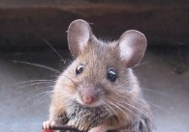

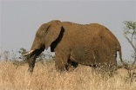
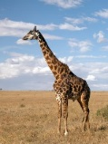
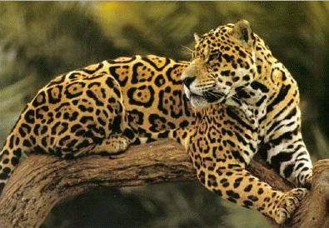


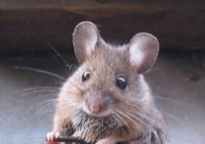

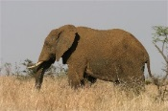

Four species
No
Colour Grey ?
Yes
Neck > 1.5 m ?
Mass > 2000 kg ?
No
Yes
No
Yes

Slide 27

Bootstrap
Complete data
Training data
Out of bag
1 2 3 4 5 6 7 8 9 10
2 4 8 9 10 6 1 1 7 6
3 5
1 2 3 4 5 6 7 8 9 10
1 10 10 4 1 4 10 1 9 9
2 3 5 6 7 8
1 2 3 4 5 6 7 8 9 10
10 1 10 5 4 1 10 7 2 2
3 6 8 9
1 2 3 4 5 6 7 8 9 10
9 6 1 9 2 3 5 10 9 2
4 7 8
1 2 3 4 5 6 7 8 9 10
10 10 8 5 8 7 9 8 3 8
1 2 4 6
.
.
.
.
.
.
.
.
.

Slide 28
Internal cross validation using ‘out of bag’ samples
Test set
Training data
Out of bag
1
2
3
4
5
…
2 4 8 9 10 6 1 1 7 6
3 5
1 10 10 4 1 4 10 1 9 9
2 3 5 6 7 8
10 1 10 5 4 1 10 7 2 2
3 6 8 9
9 6 1 9 2 3 5 10 9 2
4 7 8
10 10 8 5 8 7 9 8 3 8
1 2 4 6
.
.
.
.
.
.
.
.
.
.
.
.
.
.
.
.
.
.
For each sample predict class: Use only trees for which it belongs to the OOB set
Good estimate of test error: Information from i was not used for building these trees

Slide 29
Variable importance
Idea: change values of a variable and check whether the OOB error changes dramatically
For each variable x do the following:
  For each tree of a forest permute the values of x for the ‘out of bag’ samples
  Redo the classification for the OOB samples
  Compare the OOB error with original OOB error
    If unchanged, or just a bit: variable was not so important
    If error increases a lot: variable was important
Also: quantify the increase in impurity

Slide 30
Variable selection to obtain small sets
Backward elimination procedure
  Using variable importance from permutations
  Using OOB classification error
Procedure
  Delete, iteratively, 20% variables with lowest importance
  So: series of forests with decreasing numbers of vars
  Compare their OOB errors
    Choose smallest set within 1 st.error of the best (with min. error)
Díaz-Uriarte and De Andrés, 2006

Slide 31
Some criticism
Breiman claims: no overfitting
  Segal (2004): maybe due to the UCI data sets used
  Overfitting when many highly correlated variables
Strobl et al. (2006)
  Random forests systematically prefer categorical variables with more categories over those with less
  Use subsampling instead of bootstrap
  Use smaller trees

Slide 32
References
  Acharjee et al. (2016), Integration of metabolomics, lipidomics and clinical data using a machine learning method. BMC Bioinformatics, 17(15):440
  Acharjee et al. (2016), Integration of multi-omics data for prediction of phenotypic traits using random forest. BMC Bioinformatics, 6;17 (5):180
  Acharjee et al. (2011), Data integration and network reconstruction with ~omics data using Random Forest regression in potato. Analytica Chimica Acta, 705(1-2):56-63.
  Breiman (2001), Random forests. Machine learning, 45: 5-32
  Segal (2004), Machine learning benchmarks and random forest regression. Techn. Paper.

Slide 33
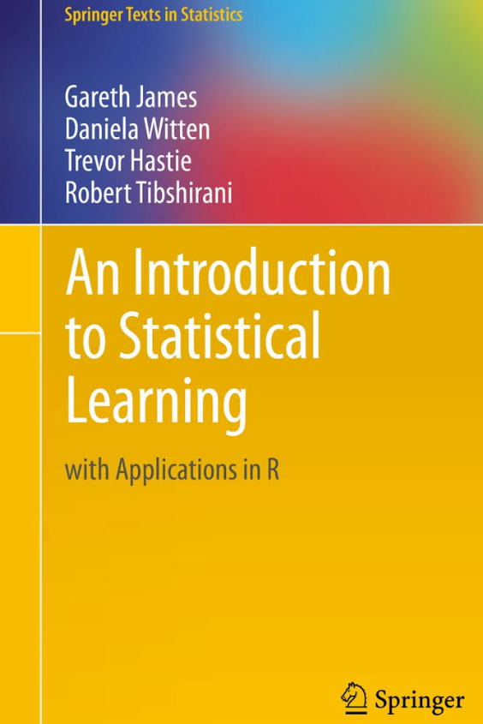


Resources
http://www-bcf.usc.edu/~gareth/ISL/ISLR%20Sixth%20Printing.pdf

Slide 34
Agenda
Introduction : Biomarker Discovery
Classification & regression
Random Forest
Hands on : Metabolomics data analysis

Slide 35
Data Set

Slide 36
Background
Peroxisome proliferator-activated receptors (PPARs) play a central role in regulating metabolism.
PPAR-pan agonist (a triple agonist of PPAR-α, -γ, and -δ) was investigated after dietary treatment of male rats (Sprague–Dawley)
(Ament et al., 2015)
Classical toxicological tests (clinical chemistry) & liver metabolomic and lipidomic changes were measured in order to understand metabolism and toxicity.
Notes:
Need more concrete back ground. Agonist: a substance which initiates a physiological response when combined with a receptor
Dyslipidaemias: Lipid related diseases

Slide 37
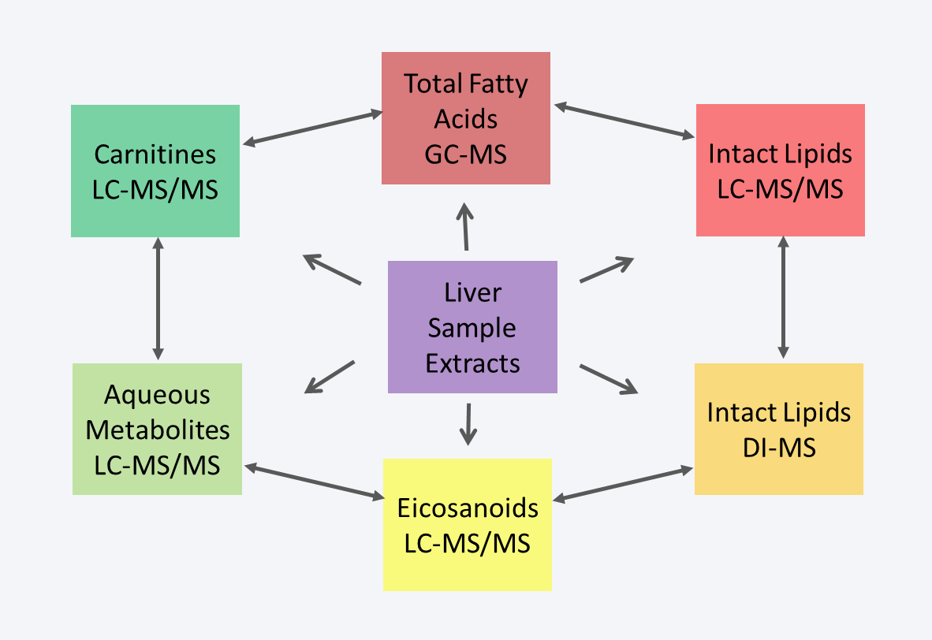
Data information
Different responses
      Dose response (Class)
      Relative liver weight (Continuous)
Classification / Regression
Random Forest

Slide 38
Study design
Group | Dose (mg/kg/day) | Animal number | Recovery
Control | 0 | 1-12 | 13-18
Low | 30 | 19-30 | -
Intermediate 1 | 100 | 31-42 | -
Intermediate 2 | 300 | 43-54 | 55-60
High | 1000 | 61-72 | 73-78
Number of total groups/class : 8 (5 dose and 3 recovery doses)
      Relative liver weight as phenotype (Continuous)
Ament et al., 2015
Acharjee at al.,2016

Slide 39
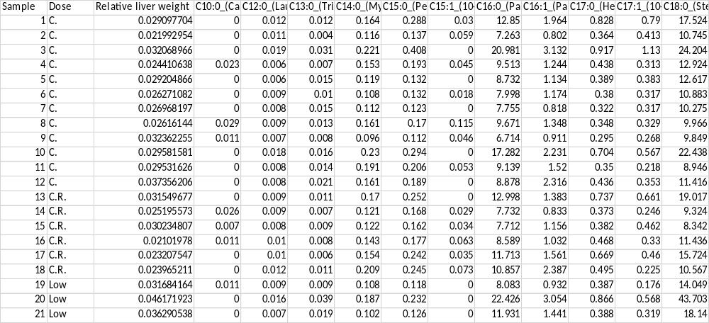
Class
Phenotype
Metabolites

Slide 40
Thank you
animesh.acharjee@gmail.com

Slide 42
Analysis Flow: Data
Model performance
Validate effect size
Reproducibility
=Control
=Treatment
Model building
Variable selection
Estimate effect size
Validation data / Test data
Discovery data / Training data

Slide 43

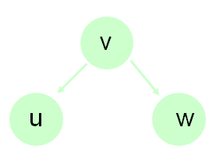

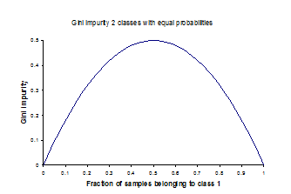

Criteria for splitting
Search, per step, ‘best’ variable and split point
  Each step: splitting only one of the nodes into two
  ‘best’: decreasing ‘impurity’ most
  E.g. Gini index
p_{u} = fraction of samples in node u
p_{w} = fraction of samples in node w
Impurity single node, 2 classes equal probabilities:

Slide 44
Stopping criteria
All nodes are pure (single class) or have a ‘final’ number of elements, e.g. 5
Prune the tree back somewhat
  Remove splits with low decrease in impurity
  To protect against overfitting
Unpruned trees
  Low bias (end nodes have maximum purity)
  High variance
    Widely different rules if the data or the samples change a little

Slide 45
New sample: each tree casts vote, then majority voting
Complete data
Training data
1 2 3 4 5 6 7 8 9 10
2 4 8 9 10 6 1 1 7 6
1 2 3 4 5 6 7 8 9 10
1 10 10 4 1 4 10 1 9 9
1 2 3 4 5 6 7 8 9 10
10 1 10 5 4 1 10 7 2 2
1 2 3 4 5 6 7 8 9 10
9 6 1 9 2 3 5 10 9 2
1 2 3 4 5 6 7 8 9 10
10 10 8 5 8 7 9 8 3 8
.
.
.
.
.
.
.
.
.
.
.
.

